Slide 1
Entropy and mutual information for search problems
Single agent - Single cell
Single agent - Multi cells
Multi agents - Multi cells
Multi agents - Multi sensors per agent - Multi cells
Decision making by expected mutual information
Converge rate
Moving Targets

Slide 2


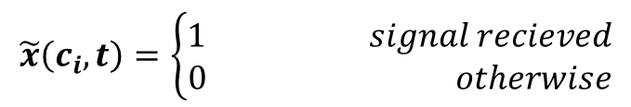
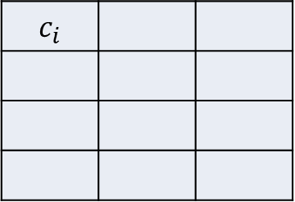



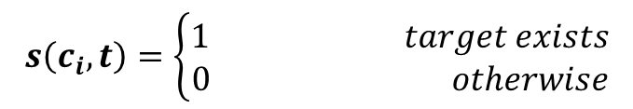

Single agent
$$s\left(c_{i},t\right)=\left\{\begin{aligned}1 target exists \\ 0 otherwise\end{aligned}\right.$$
 |  | $$c_{i}$$
$P\left\{s\left(c_{i},t\right)=1\right\}+P\left\{s\left(c_{i},t\right)=0\right\}=1$,
$$\tilde{x}\left(c_{i},t\right)=\left\{\begin{aligned}1 signal recieved \\ 0 otherwise\end{aligned}\right.$$
$$c_{j}$$
$\tilde{a}\left(c_{i},t\right)=1$ - $alarm sent from c_{i}$
$$Pr\left\{\tilde{a}\left(c_{i},t\right)=1│s\left(c_{i},t\right)=1\right\}=P_{TA}$$
$Pr\left\{\tilde{a}\left(c_{i},t\right)=1│s\left(c_{i},t\right)=0\right\}=P_{FA}=α∙$ $P_{TA}$ $0≤α≤1$
$$λ\left(𝕊\right)−sensor k power$$
$$r_{ij}−The distance between (c_{i},c_{j})$$
$$Pr\left\{signal rercieved by the sensor | alarm sent from c_{i}\right\}=e^{−\frac{r_{ij}}{λ\left(𝕤\right)}}$$

Slide 3



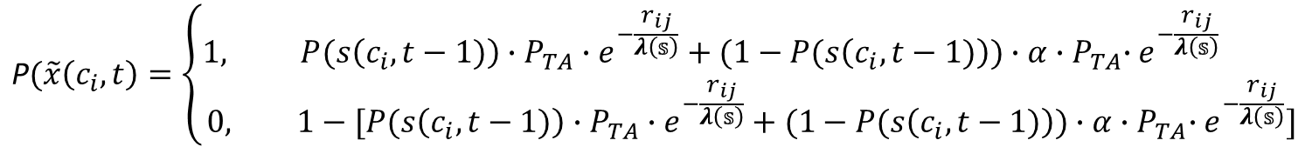
















Single agent - Single cell
$$\text{P}(\tilde{x}\left(c_{i},t\right)=\left\{\begin{aligned}1, P(s\left(c_{i},t−1)\right)∙P_{TA}∙e^{−\frac{r_{ij}}{λ\left(𝕤\right)}}+(1−P(s\left(c_{i},t−1)\right))∙α{{∙P}_{TA}∙e}^{−\frac{r_{ij}}{λ\left(𝕤\right)}} \\ &0, 1−[P(s\left(c_{i},t−1)\right)∙P_{TA}∙e^{−\frac{r_{ij}}{λ\left(𝕤\right)}}+(1−P(s\left(c_{i},t−1)\right))∙α{{∙P}_{TA}∙e}^{−\frac{r_{ij}}{λ\left(𝕤\right)}}]\end{aligned}\right.$$
$$1−P(s\left(c_{i},t−1)\right)$$
$$P(s\left(c_{i},t−1)\right)$$
$${1−α∙P}_{TA}$$
$${α∙P}_{TA}$$
$${1−P}_{TA}$$
$$P_{TA}$$
$$e^{−\frac{r_{ij}}{λ\left(𝕤\right)}}$$
$$e^{−\frac{r_{ij}}{λ\left(𝕤\right)}}$$
$$e^{−\frac{r_{ij}}{λ\left(𝕤\right)}}$$
$$e^{−\frac{r_{ij}}{λ\left(𝕤\right)}}$$
$${1−e}^{−\frac{r_{ij}}{λ\left(𝕤\right)}}$$
$${1−e}^{−\frac{r_{ij}}{λ\left(𝕤\right)}}$$
$${1−e}^{−\frac{r_{ij}}{λ\left(𝕤\right)}}$$
$${1−e}^{−\frac{r_{ij}}{λ\left(𝕤\right)}}$$
$$\tilde{x}\left(c_{i},t\right)=$$
$$0$$
$$0$$
$$0$$
$$1$$
$$0$$
$$0$$
$$0$$
$$1$$

Slide 4
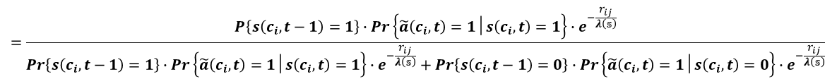
Sensor Probability Updating with false positive and false negative
$P\left\{s\left(c_{i},t\right)=1 | \tilde{x}\left(c_{i},t\right)=1\right\}=$ $\frac{P\left\{s\left(c_{i},t−1\right)=1\right\}∙P\left\{\tilde{x}\left(c_{i},t\right)=1│s\left(c_{i},t\right)=1\right\}}{P\left\{s\left(c_{i},t−1\right)=1\right\}∙P\left\{\tilde{x}\left(c_{i},t\right)=1│s\left(c_{i},t\right)=1\right\}+P\left\{s\left(c_{i},t−1\right)=0\right\}∙P\left\{\tilde{x}\left(c_{i},t\right)=1│s\left(c_{i},t\right)=0\right\}}$
$$=\frac{P\left\{s\left(c_{i},t−1\right)=1\right\}∙Pr\left\{\tilde{a}\left(c_{i},t\right)=1│s\left(c_{i},t\right)=1\right\}∙e^{−\frac{r_{ij}}{λ\left(𝕤\right)}}}{Pr\left\{s\left(c_{i},t−1\right)=1\right\}∙Pr\left\{\tilde{a}\left(c_{i},t\right)=1│s\left(c_{i},t\right)=1\right\}∙e^{−\frac{r_{ij}}{λ\left(𝕤\right)}}+Pr\left\{s\left(c_{i},t−1\right)=0\right\}∙Pr\left\{\tilde{a}\left(c_{i},t\right)=1│s\left(c_{i},t\right)=0\right\}∙e^{−\frac{r_{ij}}{λ\left(𝕤\right)}}}$$
$P\left\{s\left(c_{i},t\right)=1 | x\left(c_{i},t\right)=0\right\}=$ $\frac{P\left\{s\left(c_{i},t−1\right)=1\right\}∙Pr\left\{\tilde{x}\left(c_{i},t\right)=0│s\left(c_{i},t\right)=1\right\}}{P\left\{s\left(c_{i},t−1\right)=1\right\}∙P\left\{\tilde{x}\left(c_{i},t\right)=0│s\left(c_{i},t\right)=1\right\}+P\left\{s\left(c_{i},t−1\right)=0\right\}∙P\left\{\tilde{x}\left(c_{i},t\right)=0│s\left(c_{i},t\right)=0\right\}}$
= $\frac{Pr\left\{s\left(c_{i},t−1\right)=1\right\}∙\text{[}P\left\{\tilde{a}\left(c_{i},t\right)=0│s\left(c_{i},t\right)=1\right\}+Pr\left\{\tilde{a}\left(c_{i},t\right)=1│s\left(c_{i},t\right)=1\right\}⋅\{1−e^{−\frac{r_{ij}}{λ\left(𝕤\right)}}\}]}{Pr\left\{s\left(c_{i},t−1\right)=1\right\}∙\text{[}Pr\left\{\tilde{a}\left(c_{i},t\right)=0│s\left(c_{i},t\right)=1\right\}+Pr\left\{\tilde{a}\left(c_{i},t\right)=1│s\left(c_{i},t\right)=1\right\}⋅\{1−e^{−\frac{r_{ij}}{λ\left(𝕤\right)}}\}]+Pr\left\{s\left(c_{i},t−1\right)=0\right\}⋅\text{[}Pr\left\{\tilde{a}\left(c_{i},t\right)=0│s\left(c_{i},t\right)=0\right\}\text{+}Pr\left\{\tilde{a}\left(c_{i},t\right)=1│s\left(c_{i},t\right)=0\right\}⋅\{1−e^{−\frac{r_{ij}}{λ\left(𝕤\right)}}\}]}$
4

Slide 5











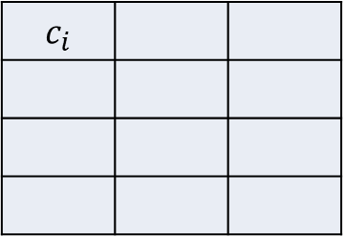



Single agent - Single cell - Cell probability updating
 |  | $$c_{i}$$
$P\left\{s\left(c_{i},t\right) |\tilde{x}\left(c_{i},t\right)=1\right\}=$ $\frac{P\left\{s\left(c_{i},t−1\right)\right\}∙P_{TA}}{P\left\{s\left(c_{i},t−1\right)\right\}∙P_{TA}+[1−P\left\{s\left(c_{i},t−1\right)\right\}]∙α∙P_{TA}}$
$$c_{j}$$
$$P\left\{s\left(c_{i},t\right) |\tilde{x}\left(c_{i},t\right)=0\right\}=\frac{P\left\{s\left(c_{i},t−1\right)\right\}∙\text{[}\left(1−P_{TA}\right)+P_{TA}⋅(1−e^{−\frac{r_{ij}}{λ\left(k\right)}})]}{P\left\{s\left(c_{i},t−1\right)\right\}∙\text{[}\left(1−P_{TA}\right)+P_{TA}⋅(1−e^{−\frac{r_{ij}}{λ\left(k\right)}})]+[1−P\left\{s\left(c_{i},t−1\right)\right\}]⋅\text{[}(1−α∙P_{TA}\text{)}\text{+}α∙P_{TA}⋅(1−e^{−\frac{r_{ij}}{λ\left(k\right)}})]}$$
$$P\left\{s\left(c_{i},t−1\right)\right\}$$
$$\tilde{x}\left(c_{i},t\right)=0$$
$$\tilde{x}\left(c_{i},t\right)=1$$
$$P\left\{s\left(c_{i},t\right) \right\}$$
$$P\left\{s\left(c_{i},t\right) \right\}$$
$$\tilde{x}\left(c_{i},t+1\right)=0$$
$$\tilde{x}\left(c_{i},t+1\right)=1$$
$$\tilde{x}\left(c_{i},t+1\right)=0$$
$$\tilde{x}\left(c_{i},t+1\right)=1$$
$$P\left\{s\left(c_{i},t+1\right) \right\}$$
$$P\left\{s\left(c_{i},t+1\right) \right\}$$
$$P\left\{s\left(c_{i},t+1\right) \right\}$$
$$P\left\{s\left(c_{i},t+1\right) \right\}$$

Slide 6



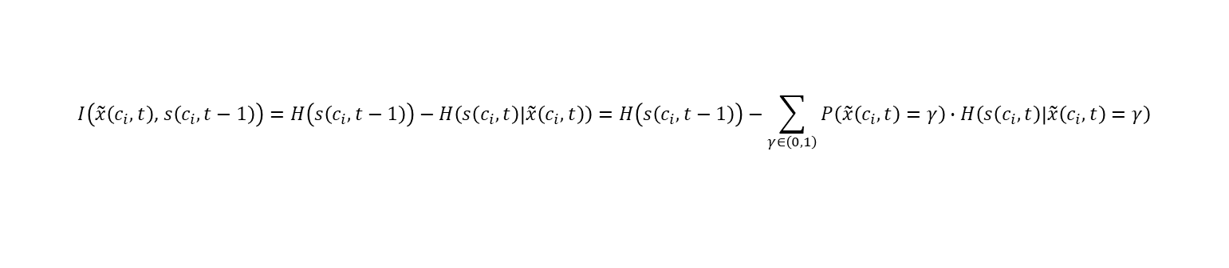





Single agent - Single cell - Entropy and mutual information
$$I\left(\tilde{x}\left(c_{i},t\right)\text{,} s\left(c_{i},t−1\right)\right)=H\left(s\left(c_{i},t−1\right)\right)−H\left(s\left(c_{i},t\right) | \tilde{x}\left(c_{i},t\right)\right)=H\left(s\left(c_{i},t−1\right)\right)−\sum_{γ∈\left(0,1\right)}{P\left(\tilde{x}\left(c_{i},t\right)=γ\right)∙H\left(s\left(c_{i},t\right) | \tilde{x}\left(c_{i},t\right)=γ\right)}$$
$$I\left(\tilde{x}\left(c_{i},t\right)\text{,} s\left(c_{i},t−1\right)\right)=$$
$P\left(s\left(c_{i},t−1\right)\right)∙\log{\frac{1}{P\left(s\left(c_{i},t−1\right)\right)}+(1−P(s\left(c_{i},t−1\right))∙\log{\frac{1}{ (1−P(s\left(c_{i},t−1\right))}}}−$
$$P_{TA}∙e^{−\frac{r_{ij}}{λ\left(k\right)}}∙\left[P(s\left(c_{i},t−1)\right)∙\log{\frac{P(s\left(c_{i},t−1)\right)+α∙(1−P(s\left(c_{i},t)\right))}{P(s\left(c_{i},t\right)}}+α∙(1−P(s\left(c_{i},t−1)\right)∙\log{\frac{P(s\left(c_{i},t)\right)+α∙(1−P(s\left(c_{i},t−1)\right))}{α∙(1−P(s\left(c_{i},t−1)\right))}}\right]−$$
$$P(s\left(c_{i},t−1)\right)∙\left(1−P_{TA}∙e^{−\frac{r_{ij}}{λ\left(k\right)}}\right)\log{\frac{P(s\left(c_{i},t−1)\right)∙\left(1−P_{TA}∙e^{−\frac{r_{ij}}{λ\left(k\right)}}\right)+(1−P(s\left(c_{i},t−1)\right))∙(1−P_{TA}∙α∙e^{−\frac{r_{ij}}{λ\left(k\right)}})}{P(s\left(c_{i},t−1)\right)∙\left(1−P_{TA}∙e^{−\frac{r_{ij}}{λ\left(k\right)}}\right)}−}$$
$$(1−P(s\left(c_{i},t−1))\right)∙(1−P_{TA}∙α∙e^{−\frac{r_{ij}}{λ\left(k\right)}})∙\log{\frac{P(s\left(c_{i},t−1)\right)∙\left(1−P_{TA}∙e^{−\frac{r_{ij}}{λ\left(k\right)}}\right)+(1−P(s\left(c_{i},t−1)\right))∙(1−P_{TA}∙α∙e^{−\frac{r_{ij}}{λ\left(k\right)}})}{ (1−P(s\left(c_{i},t−1))\right)∙(1−P_{TA}∙α∙e^{−\frac{r_{ij}}{λ\left(k\right)}})}}$$
$$H\left(s\left(c_{i},t−1\right)\right)$$
$$P\left\{s\left(c_{i},t−1\right)\right\}$$
$$\tilde{x}\left(c_{i},t\right)=0$$
$$\tilde{x}\left(c_{i},t\right)=1$$
$$H\left(s\left(c_{i},t\right)\right)$$
$$H\left(s\left(c_{i},t\right)\right)=H\left(s\left(c_{i},t−1\right)\right)−I\left(\tilde{x}\left(c_{i},t\right)\text{,} s\left(c_{i},t−1\right)\right)$$
$$P\left\{s\left(c_{i},t\right) \right\}$$
$$P\left\{s\left(c_{i},t\right) \right\}$$

Slide 7




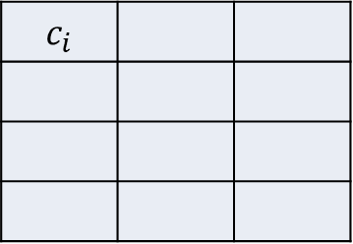
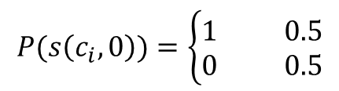
Single agent - Single cell - Example
$P_{TA}=1$ , $α=0$ , $\frac{r_{ij}}{λ\left(k\right)}=1$
 |  | $$c_{i}$$
If there isn’t prior information:
$$P(s\left(c_{i},0\right))=\left\{\begin{aligned}1 0.5 \\ 0 0.5\end{aligned}\right.$$
- Uniform distribution
$$c_{j}$$
$$H\left(c_{i},0\right)=\log{2=1[bits]}$$
$$Pr\left\{signal rercieved| alarm sent from c_{i}\right\}=e^{−1}=0.36$$
$$\text{P}(\tilde{x}\left(c_{i},1)\right)=\left\{\begin{aligned}1 P(s\left(c_{i},0)\right)∙P_{TA}∙e^{−\frac{r_{ij}}{λ\left(𝕤\right)}}=0.18 \\ 0 1−P(s\left(c_{i},0)\right)∙P_{TA}∙e^{−\frac{r_{ij}}{λ\left(𝕤\right)}}=0.82 \end{aligned}\right.$$
$P\left\{s\left(c_{i},1\right) |\tilde{x}\left(c_{i},1\right)=1\right\}=$ $\frac{P\left\{s\left(c_{i},0\right)\right\}∙P_{TA}}{P\left\{s\left(c_{i},0\right)\right\}∙P_{TA}}=1$
$$P\left\{s\left(c_{i},1\right) |\tilde{x}\left(c_{i},t\right)=0\right\}=\frac{P\left\{s\left(c_{i},0\right)\right\}∙\text{[}\left(1−P_{TA}\right)+P_{TA}⋅(1−e^{−1})]}{P\left\{s\left(c_{i},0\right)\right\}∙\text{[}\left(1−P_{TA}\right)+P_{TA}⋅(1−e^{−1})]+[1−P\left\{s\left(c_{i},0\right)\right\}]}=0.39$$
$$I\left(\tilde{x}\left(c_{i},1\right)\text{,} s\left(c_{i},0\right)\right)=0.21$$
$$H\left(s\left(c_{i},1\right)\right)=H\left(s\left(c_{i},0\right)\right)−I\left(\tilde{x}\left(c_{i},1\right)\text{,} s\left(c_{i},0\right)\right)=1−0.21=0.79[bits]$$

Slide 8






















Single agent - Single cell - Example
$$c_{i}$$
$$t=0$$
$$H\left(s\left(c_{i},0\right)\right)=1[bits]$$
$$P\{s\left(c_{i},0\right)\}=0.5$$
$$\tilde{x}\left(c_{i},1\right)=1$$
$$\tilde{x}\left(c_{i},1\right)=0$$
$$t=1$$
$$H\left(s\left(c_{i},1\right)\right)=0.79[bits]$$
$$P\{s\left(c_{i},1\right)\}=1$$
$$P\{s\left(c_{i},1\right)\}=0.39$$
$$\tilde{x}\left(c_{i},2\right)=1$$
$$\tilde{x}\left(c_{i},2\right)=0$$
$$t=2$$
$$H\left(s\left(c_{i},2\right)\right)=0.6[bits]$$
$$P\{s\left(c_{i},2\right)\}=1$$
$$P\{s\left(c_{i},2\right)\}=0.28$$
$$\tilde{x}\left(c_{i},3\right)=1$$
$$\tilde{x}\left(c_{i},3\right)=0$$
$$t=3$$
$$H\left(s\left(c_{i},3\right)\right)=0.45[bits]$$
$$P\{s\left(c_{i},3\right)\}=1$$
$$P\{s\left(c_{i},3\right)\}=0.2$$

Slide 9
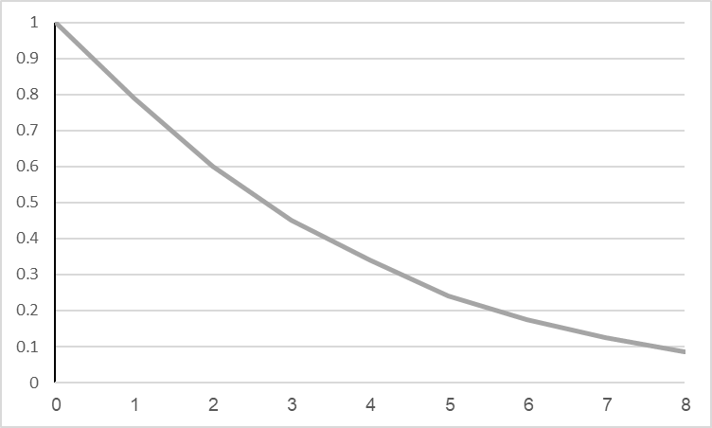

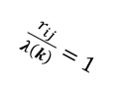


Single agent
$P_{TA}=1$ , $α=0$
Static agent
$$H\left(s\left(c_{i},t\right)\right)$$
[bits]
$\frac{r_{ij}}{λ\left(k\right)}=1$
$$t$$

Slide 10
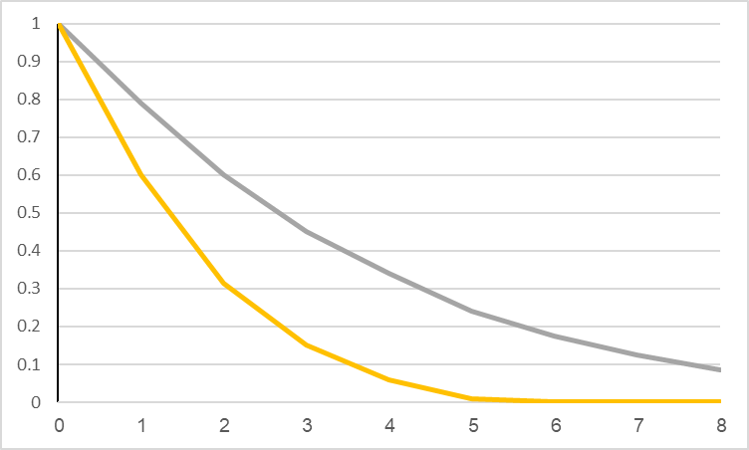
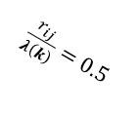
Single agent - Single cell - Example
$P_{TA}=1$ , $α=0$
Static agent
$$H\left(s\left(c_{i},t\right)\right)$$
[bits]
$\frac{r_{ij}}{λ\left(k\right)}=1$
$\frac{r_{ij}}{λ\left(k\right)}=0.5$
$$t$$

Slide 11








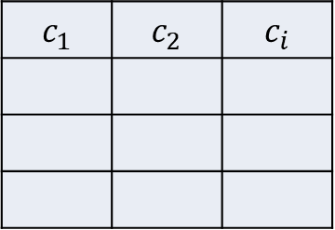

Single agent - Multi cells
$$c_{i}$$ | $$c_{2}$$ | $$c_{1}$$
$S\left(t\right)$- The status of the domain (N cells)
(0,0,0…….0,0)
(1,0,0…….0,0)
.
.
.
(0,0,0…….0,1)
(1,1,1…….1,1)
$$S\left(t\right)=$$
$2^{N}−options$
$$c_{j}$$
$S_{w}\left(t\right)=\{S_{w}^{1}\left(t\right),S_{w}^{2}\left(t\right)$…. $S_{w}^{N}\left(t\right)$}
If there isn’t prior information:
Uniform distribution -
$$P(S_{w}(t=0))=\frac{1}{2^{N}}$$
$w∈(1,2……$ $2^{N}$)
$$H\left(S\left(t=0\right)\right)=\log{2^{N}=N}$$
$$0≤H\left(S(t)\right)≤N$$

Slide 12
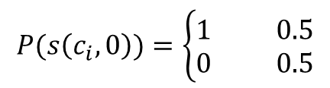



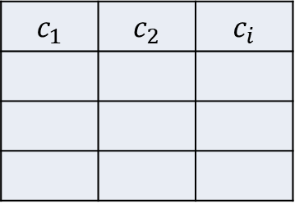
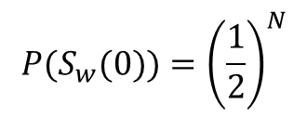
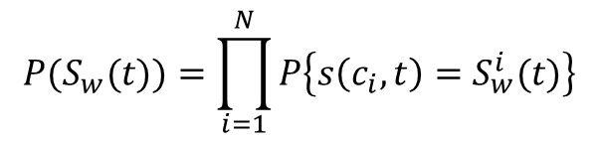
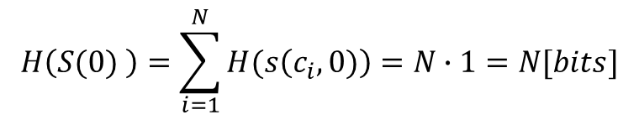
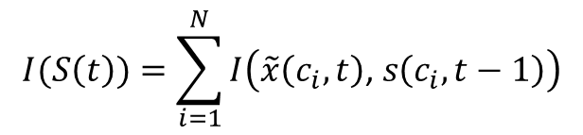
Single agent
$$c_{i}$$ | $$c_{2}$$ | $$c_{1}$$
$P\left\{s\left(c_{i},t\right)\text{│}s\left(c_{ν},t\right)\right\}=P\left\{s\left(c_{i},t\right)\right\}$ - The cells status are independent
$$P(S_{w}(t))=\prod_{i=1}^{N}{P\left\{s\left(c_{i},t\right)=S_{w}^{i}(t)\right\}}$$
$$c_{j}$$
$$H\left(S(t) \right)=\sum_{i=1}^{N}{H(s\left(c_{i},t)\right)}$$
$$I(S\left(t\right))=\sum_{i=1}^{N}{I\left(\tilde{x}\left(c_{i},t\right)\text{,} s\left(c_{i},t−1\right)\right)}$$
$$P(s\left(c_{i},0\right))=\left\{\begin{aligned}1 0.5 \\ 0 0.5\end{aligned}\right.$$
If there isn’t prior information:
Uniform distribution
$$H\left(c_{i},0\right)=\log{2=1}[bits]$$
$$0≤H(s\left(c_{i},t\right))≤1$$
$$P(S_{w}(0))={\left(\frac{1}{2}\right)}^{N}$$
$$H\left(S(0) \right)=\sum_{i=1}^{N}{H(s\left(c_{i},0)\right)}=N∙1=N[bits]$$

Slide 13

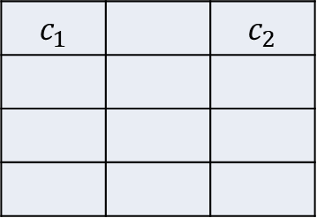

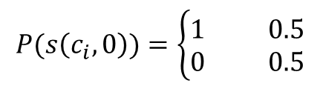



Single agent - Multi cells – Example 1
(0,0) 0.25
(1,0) 0.25
(0,1) 0.25
(1,1) 0.25
$$c_{2}$$ |  | $$c_{1}$$
$$S\left(t\right)=$$
$2^{2}=4−options$
$P_{TA}=1$ , $α=0$ ,$\frac{r_{ij}}{λ\left(k\right)}=1$
Static agent
$$Pr\left\{signal rercieved| alarm sent from c_{i}\right\}=e^{−1}=0.36$$
$$\text{P}(\tilde{x}\left(c_{i},1\right)=\left\{\begin{aligned}1 P(s\left(c_{i},0)\right)∙P_{TA}∙e^{−\frac{r_{ij}}{λ\left(k\right)}}=0.18 \\ 0 1−P(s\left(c_{i},0)\right)∙P_{TA}∙e^{−\frac{r_{ij}}{λ\left(k\right)}}=0.82 \end{aligned}\right.$$
$$P(s\left(c_{i},0\right))=\left\{\begin{aligned}1 0.5 \\ 0 0.5\end{aligned}\right.$$
$$H(s\left(c_{i},0\right))=\log{2=1[bits]}$$
$$H\left(S(0) \right)=\sum_{i=1}^{2}{H(s\left(c_{i},0)\right)=2[bits]}$$

Slide 14
































Single agent - Multi cells – Example 1
$$c_{1}$$
$$c_{2}$$
$H\left(S(0) \right)$=2
$$t=0$$
$$P\left\{s\left(c_{1},0\right)\right\}=0.5$$
$$P\{s\left(c_{2},0\right)\}=0.5$$
$$\tilde{x}\left(c_{1},1\right)=1$$
$$\tilde{x}\left(c_{1},1\right)=0$$
$$\tilde{x}\left(c_{2},1\right)=1$$
$$\tilde{x}\left(c_{2},1\right)=0$$
$$t=1$$
$H\left(S(1) \right)$=1.58
$$P\{s\left(c_{1},1\right)\}=1$$
$$P\{s\left(c_{1},1\right)\}=0.39$$
$$P\{s\left(c_{2},1\right)\}=1$$
$$P\{s\left(c_{2},1\right)\}=0.39$$
$$\tilde{x}\left(c_{1},2\right)=1$$
$$\tilde{x}\left(c_{1},2\right)=0$$
$$\tilde{x}\left(c_{2},2\right)=1$$
$$\tilde{x}\left(c_{2},2\right)=0$$
$H\left(S(2) \right)$=1.21
$$t=2$$
$$P\{s\left(c_{1},2\right)\}=1$$
$$P\{s\left(c_{1},2\right)\}=0.28$$
$$P\{s\left(c_{2},2\right)\}=1$$
$$P\{s\left(c_{2},2\right)\}=0.28$$
$$\tilde{x}\left(c_{1},3\right)=1$$
$$\tilde{x}\left(c_{1},3\right)=0$$
$$\tilde{x}\left(c_{2},3\right)=1$$
$$\tilde{x}\left(c_{2},3\right)=0$$
$H\left(S(3) \right)$=0.9
$$t=3$$
$$P\{s\left(c_{1},3\right)\}=1$$
$$P\{s\left(c_{1},3\right)\}=0.2$$
$$P\{s\left(c_{2},3\right)\}=1$$
$$P\{s\left(c_{2},3\right)\}=0.2$$

Slide 15
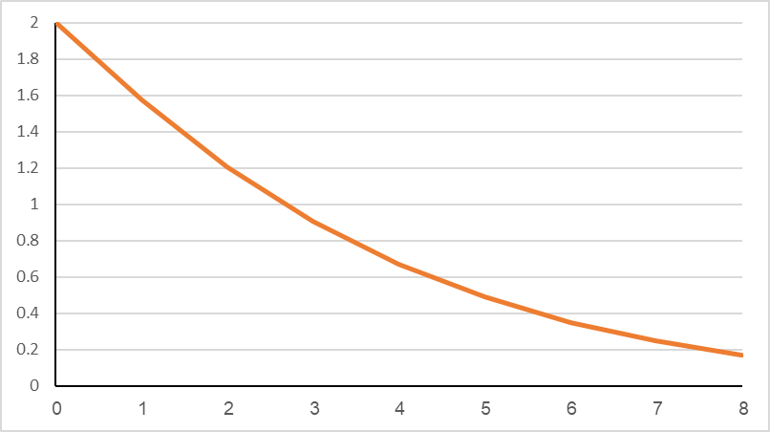



Single agent - Multi cells – Example 1
$P_{TA}=1$ , $α=0$ , $\frac{r_{ij}}{λ\left(k\right)}=1$
Static agent – 2 cells
$$H\left(S(t) \right)$$
[bits]
$$t$$

Slide 16

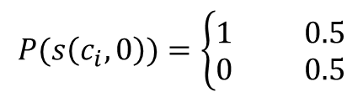


Single agent - Multi cells – Example 2
(0,0) 0.25
(1,0) 0.25
(0,1) 0.25
(1,1) 0.25
$$c_{2}$$ |  | $$c_{1}$$
$$S\left(t\right)=$$
$2^{2}=4−options$
$P_{TA}=1$ , $α=0.25$ ,$\frac{r_{ij}}{λ\left(k\right)}=1$
Static agent
$$P(s\left(c_{i},0\right))=\left\{\begin{aligned}1 0.5 \\ 0 0.5\end{aligned}\right.$$
$$H(s\left(c_{i},0\right))=\log{2=1[bits]}$$
$$H\left(S(0) \right)=\sum_{i=1}^{2}{H(s\left(c_{i},0)\right)=2[bits]}$$
$$\tilde{x}\left(c_{i},1\right)=\left\{\begin{aligned}1 P(s\left(c_{i},0)\right)∙P_{TA}∙e^{−\frac{r_{ij}}{λ\left(𝕤\right)}}+(1−P(s\left(c_{i},0)\right))∙α{{∙P}_{TA}∙e}^{−\frac{r_{ij}}{λ\left(𝕤\right)}}=0.18+0.045=0.225 \\ 0 1−[P(s\left(c_{i},0)\right)∙P_{TA}∙e^{−\frac{r_{ij}}{λ\left(𝕤\right)}}+(1−P(s\left(c_{i},0)\right))∙α{{∙P}_{TA}∙e}^{−\frac{r_{ij}}{λ\left(𝕤\right)}}]=0.775 \end{aligned}\right.$$

Slide 17
































Single agent - Multi cells – Example 2
$$c_{1}$$
$$c_{2}$$
$H\left(S(0) \right)$=2
$$t=0$$
$$P\left\{s\left(c_{1},0\right)\right\}=0.5$$
$$P\{s\left(c_{2},0\right)\}=0.5$$
$$\tilde{x}\left(c_{1},1\right)=1$$
$$\tilde{x}\left(c_{1},1\right)=0$$
$$\tilde{x}\left(c_{2},1\right)=1$$
$$\tilde{x}\left(c_{2},1\right)=0$$
$H\left(S(1) \right)$=1.84
$$t=1$$
$$P\{s\left(c_{1},1\right)\}=0.8$$
$$P\{s\left(c_{1},1\right)\}=0.41$$
$$P\{s\left(c_{2},1\right)\}=0.8$$
$P\{s\left(c_{2},1\right)\}=0.$41
$$\tilde{x}\left(c_{1},2\right)=1$$
$$\tilde{x}\left(c_{1},2\right)=1$$
$$\tilde{x}\left(c_{1},2\right)=0$$
$$\tilde{x}\left(c_{2},2\right)=1$$
$$\tilde{x}\left(c_{2},2\right)=1$$
$$\tilde{x}\left(c_{2},2\right)=0$$
$$\tilde{x}\left(c_{1},2\right)=0$$
$$\tilde{x}\left(c_{i},t\right)=0$$
$H\left(S(2) \right)$=1.69
$$t=2$$
$$P\{s\left(c_{1},2\right)\}=0.94$$
$$P\{s\left(c_{1},2\right)\}=0.73$$
$$P\{s\left(c_{1},2\right)\}=0.73$$
$$P\{s\left(c_{1},2\right)\}=0.32$$
$P\{s\left(c_{2},2\right)\}=0.$94
$P\{s\left(c_{2},2\right)\}=$0.73
$P\{s\left(c_{2},2\right)\}=0.$73
$P\{s\left(c_{2},2\right)\}=0.$32

Slide 18
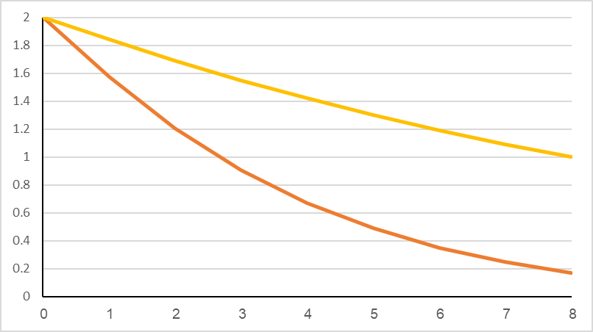




Single agent - Multi cells – Example 2
Static agent – 2 cells
$$H\left(S(t) \right)$$
$$α=0.25$$
[bits]
$$α=0$$
$$t$$

Slide 19

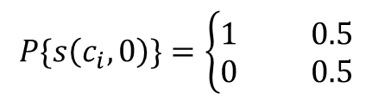


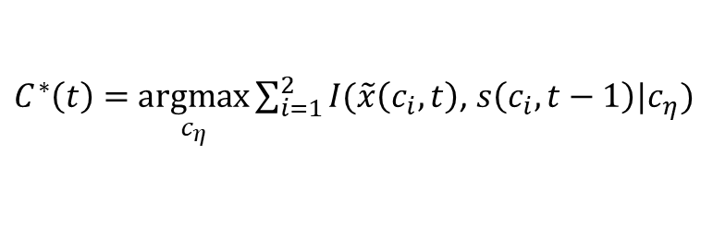
Single agent - Multi cells – Example 3
(0,0) 0.25
(1,0) 0.25
(0,1) 0.25
(1,1) 0.25
$$c_{2}$$ |  | $$c_{1}$$
$$S\left(t\right)=$$
$2^{2}=4−options$
$P_{TA}=1$ , $α=0$ , $\frac{r_{ij}}{λ\left(k\right)}=1$
Moving agent
$$P\{s\left(c_{i},0\right)\}=\left\{\begin{aligned}1 0.5 \\ 0 0.5\end{aligned}\right.$$
$$H\left(S(0) \right)=\sum_{i=1}^{2}{H(s\left(c_{i},0)\right)=2[bits]}$$
$C^{∗}\left(t\right)=$ $\underset{c_{η}}{argmax}{\sum_{i=1}^{2}{I(\tilde{x}\left(c_{i},t\right)\text{,} s\left(c_{i},t−1\right)|c_{η})}}$
$c_{η}$, $η=1,2,…,N−agent position$

Slide 20












Single agent - Multi cells – Example 3
$$c_{1}$$
$$c_{2}$$
$H\left(S(0) \right)$=2
$$t=0$$
$$P\left\{s\left(c_{1},0\right)\right\}=0.5$$
$$P\{s\left(c_{2},0\right)\}=0.5$$
$$\tilde{x}\left(c_{1},1\right)=1$$
$$\tilde{x}\left(c_{1},1\right)=0$$
$$\tilde{x}\left(c_{2},1\right)=1$$
$$\tilde{x}\left(c_{2},1\right)=0$$
$$t=1$$
$H\left(S(1) \right)$=1.42
$$P\{s\left(c_{1},1\right)\}=1$$
$P\{s\left(c_{1},1\right)\}=0.$35
$$P\{s\left(c_{2},1\right)\}=1$$
$P\{s\left(c_{2},1\right)\}=0.$35
$$\tilde{x}\left(c_{1},2\right)=1$$
$$\tilde{x}\left(c_{1},2\right)=0$$
$$\tilde{x}\left(c_{2},2\right)=1$$
$$\tilde{x}\left(c_{2},2\right)=0$$
$H\left(S(2) \right)$=0.62
$$t=2$$
$$P\{s\left(c_{1},2\right)\}=1$$
$P\{s\left(c_{1},2\right)\}=0.$17
$$P\{s\left(c_{2},2\right)\}=1$$
$P\{s\left(c_{2},2\right)\}=0.$17
$$\tilde{x}\left(c_{1},3\right)=1$$
$$\tilde{x}\left(c_{1},3\right)=0$$
$$\tilde{x}\left(c_{2},3\right)=1$$
$$\tilde{x}\left(c_{2},3\right)=0$$
$H\left(S(3) \right)$=0.1
$$t=3$$

Slide 21
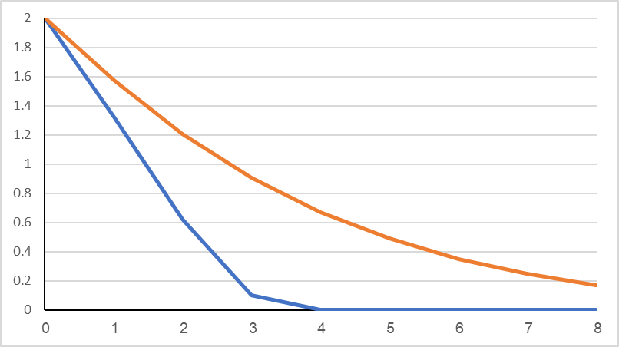



Single agent - Multi cells – Example 3
$P_{TA}=1$ , $α=0$
Static vs. moving agent – 2 cells
$$H\left(S(t) \right)$$
[bits]
Static agent
Moving agent
$$t$$

Slide 22

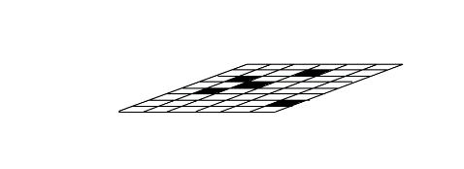






Global Map Modification
Environment
True
alarms
$${\tilde{x}}_{j1}\left(c_{i},t\right)$$
False
alarms
True
alarms
$${\tilde{x}}_{j2}\left(c_{i},t\right)$$
False
alarms
True
alarms
$${\tilde{x}}_{jk}\left(c_{i},t\right)$$
False
alarms
Sensor 1
observation
Sensor 2
observation
. . . .
Sensor k
observation
Local Sensor Map
Local Sensor Map
$$P_{jk}(S\left(t\right))$$
Sensor Integration
Local Agent Map
$$P_{j}(S\left(t\right))$$
. . . .
Agent Integration
$$P(S\left(t\right))$$
Global Map

Slide 23
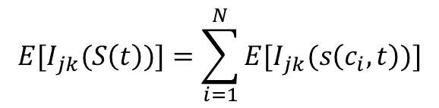

Expected sensor information
$$I\{{\tilde{x}}_{jk}\left(c_{i},t\right)\text{,} s\left(c_{i},t−1\right)\}=$$
$P\left(s\left(c_{i},t−1\right)\right)∙\log{\frac{1}{P\left(s\left(c_{i},t−1\right)\right)}+(1−P(s\left(c_{i},t−1\right))∙\log{\frac{1}{ (1−P(s\left(c_{i},t−1\right))}}}−$
$$P_{TA}∙e^{−\frac{r_{ij}}{λ\left(k\right)}}∙\left[P(s\left(c_{i},t−1)\right)∙\log{\frac{P(s\left(c_{i},t−1)\right)+α∙(1−P(s\left(c_{i},t)\right))}{P(s\left(c_{i},t\right)}}+α∙(1−P(s\left(c_{i},t−1)\right)∙\log{\frac{P(s\left(c_{i},t)\right)+α∙(1−P(s\left(c_{i},t−1)\right))}{α∙(1−P(s\left(c_{i},t−1)\right))}}\right]−$$
$$P(s\left(c_{i},t−1)\right)∙\left(1−P_{TA}∙e^{−\frac{r_{ij}}{λ\left(k\right)}}\right)\log{\frac{P(s\left(c_{i},t−1)\right)∙\left(1−P_{TA}∙e^{−\frac{r_{ij}}{λ\left(k\right)}}\right)+(1−P(s\left(c_{i},t−1)\right))∙(1−P_{TA}∙α∙e^{−\frac{r_{ij}}{λ\left(k\right)}})}{P(s\left(c_{i},t−1)\right)∙\left(1−P_{TA}∙e^{−\frac{r_{ij}}{λ\left(𝕤\right)}}\right)}−}$$
$$(1−P(s\left(c_{i},t−1))\right)∙(1−P_{TA}∙α∙e^{−\frac{r_{ij}}{λ\left(k\right)}})∙\log{\frac{P(s\left(c_{i},t−1)\right)∙\left(1−P_{TA}∙e^{−\frac{r_{ij}}{λ\left(k\right)}}\right)+(1−P(s\left(c_{i},t−1)\right))∙(1−P_{TA}∙α∙e^{−\frac{r_{ij}}{λ\left(k\right)}})}{ (1−P(s\left(c_{i},t−1))\right)∙(1−P_{TA}∙α∙e^{−\frac{r_{ij}}{λ\left(k\right)}})}}$$
Expected sensor information gain for cell $c_{i}$at time t:
$${E[I}_{jk}(s\left(c_{i},t\right))]=I\{{\tilde{x}}_{jk}\left(c_{i},t\right)\text{,} s\left(c_{i},t−1\right)\}$$
Expected sensor information gain for the domain at time t (independent cells):
$${E[I}_{jk}(S\left(t\right))]=\sum_{i=1}^{N}{{E[I}_{jk}(s\left(c_{i},t\right))]}$$

Slide 24







Decision-making by expected mutual information
Control - $V_{π}\left(t\right)$
Agent
Policy - $π$
$E\left[V_{π}\left(t\right) \right]−$Expected information gain at time t:
Observation
Action - $𝕒(t)$
True
alarms
False
alarms
$V_{π}\left(t\right)=D_{KL}\left(P^{global}\left(t\right)||P^{global}\left(t−1\right)\right)$,
$π\left(t\right)=\underset{a}{argmax}{E[V_{π}\left(t\right)]}$
Environment
Decision making / action choice | $E[V_{π}\left(t\right)$] | Number of alternatives
 |  | $$EIG$$ | $$COV$$ | $$COG$$
Agent map / agent action | $${E[I}_{j}(S\left(t\right))]$$ | $$9m$$ | $$mn$$ | $$m$$
Global map / agent action | $$E[(I(S\left(t\right))]$$ | $$9m$$ | $$mn$$ | $$1$$
Global map / group action | $$E[(I(S\left(t\right))]$$ | $$9^{m}$$ | $$n^{m}$$ | $$1$$
Integrated algorithm | ${E[I}_{j}(S\left(t\right))]$- Exploration $E[(I(S\left(t\right))]$- Exploitation | $$9^{m}$$ | $$n^{m}$$ | $$1$$

Slide 25
Entropy and mutual information for search problems
Single agent - Single cell
Single agent - Multi cells
Multi agents - Multi cells
Multi agents - Multi sensors per agent - Multi cells
Decision making by expected mutual information
Converge rate
Moving Targets

Slide 26
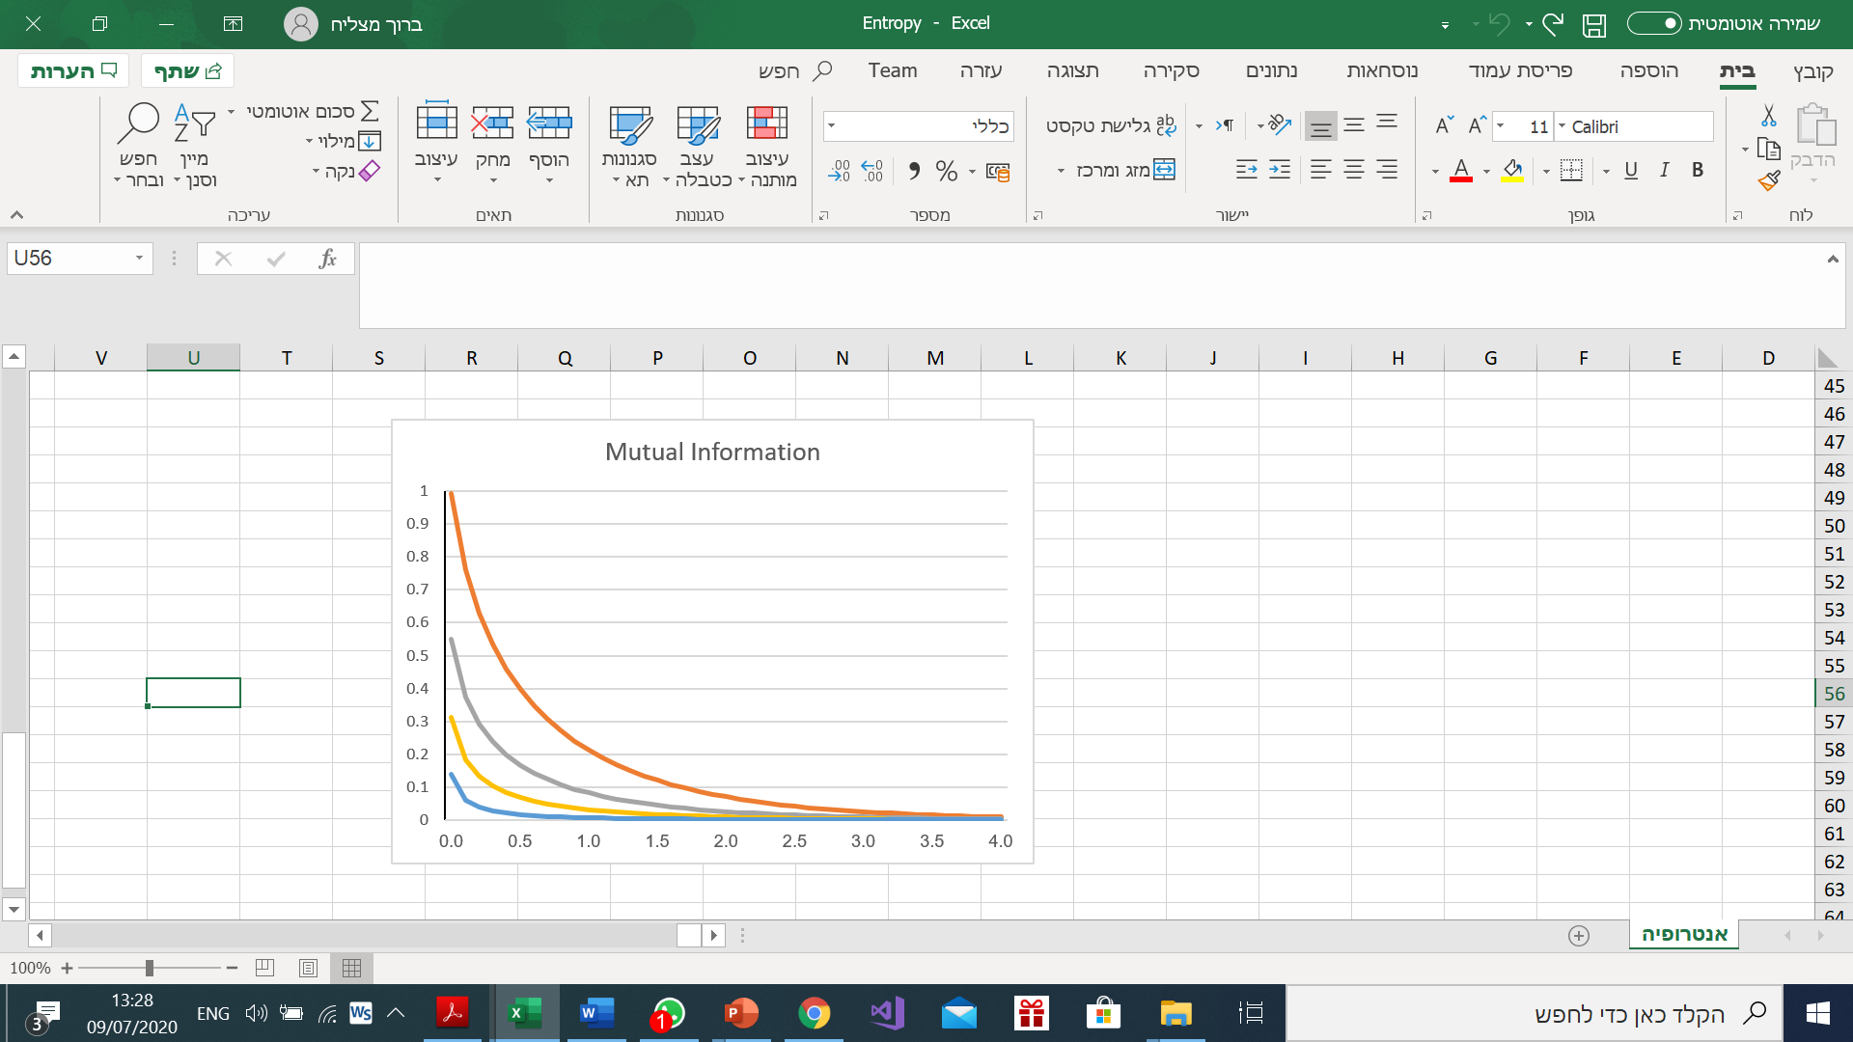
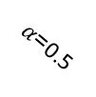

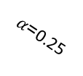
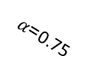

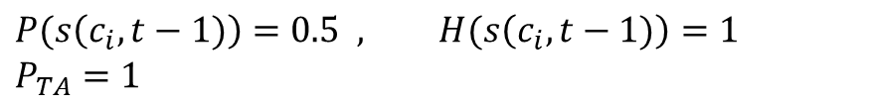

Converge rate
$$P(s\left(c_{i},t−1)\right)=0.5 , H(s\left(c_{i},t−1)\right)=1$$
$$P_{TA}=1$$
$I(\tilde{x}\left(c_{i},t\right)$, $s\left(c_{i},t−1\right))$
$α$=0
$α$=0.25
$α$=0.5
$α$=0.75
$$\frac{r_{ij}}{λ\left(k\right)}$$

Slide 27
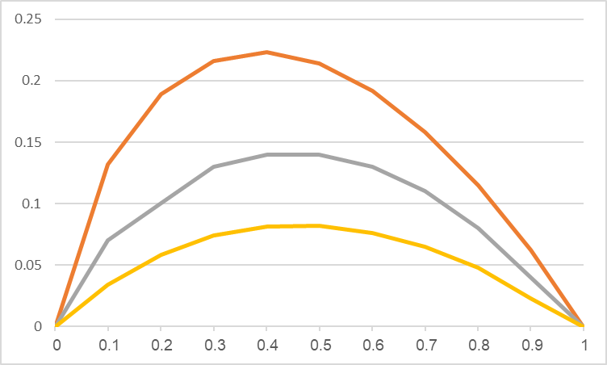






Converge rate
$P_{TA}=1$ ,$\frac{r_{ij}}{λ\left(k\right)}=1$
$α$=0
$$I(\tilde{x}\left(c_{i},t\right)\text{,} s\left(c_{i},t−1\right))$$
$α$=0.1
[bits]
$α$=0.25
$$P\left\{s\left(c_{i},t−1\right)\right\}$$

Slide 28

Converge rate
 |  | $$c_{i}$$
$P(s_{jk}\left(c_{i},t\right)|\tilde{x}\left(c_{i},t\right)=1)=$ $\frac{P(s_{jk}\left(c_{i},t−1)\right)∙P_{TA}}{P(s_{jk}\left(c_{i},t−1)\right)∙P_{TA}+[1−P(s_{jk}\left(c_{i},t−1)\right)]∙α∙P_{TA}}$
$$c_{j}$$
$$P(s_{jk}\left(c_{i},t\right)|\tilde{x}\left(c_{i},t\right)=0)=\frac{P(s_{jk}\left(c_{i},t−1)\right)∙\text{[}\left(1−P_{TA}\right)+P_{TA}⋅(1−e^{−\frac{r_{ij}}{λ\left(k\right)}})]}{P(s_{jk}\left(c_{i},t−1)\right)∙\text{[}\left(1−P_{TA}\right)+P_{TA}⋅(1−e^{−\frac{r_{ij}}{λ\left(k\right)}})]+[1−P(s_{jk}\left(c_{i},t−1)\right)]⋅\text{[}(1−α∙P_{TA}\text{)}\text{+}α∙P_{TA}⋅(1−e^{−\frac{r_{ij}}{λ\left(k\right)}})]}$$
Expected value of $P\left\{s\left(c_{i},t\right)\right\}$:
$$E(P\left\{s_{jk}\left(c_{i},t\right)\right\}=P\left\{s_{jk}\left(c_{i},t\right)|\tilde{x}\left(c_{i},t\right)=1\right\}∙P\left(\tilde{x}\left(c_{i},t\right)=1\right)+P\left\{s_{jk}\left(c_{i},t\right)|\tilde{x}\left(c_{i},t\right)=0\right\}∙P\left(\tilde{x}\left(c_{i},t\right)=0\right)$$

Slide 29


Converge rate - Target exists in $c_{i}$
 |  | $$c_{i}$$
Case 1: Target exists in $c_{i}$
Expected value of $P(s_{jk}\left(c_{i},t\right))$
$$c_{j}$$
$$E[P(s_{jk}\left(c_{i},t\right)|Tar\left(c_{i},t\right)=1)] =P((s_{jk}\left(c_{i},t\right))|\tilde{x}\left(c_{i},t\right)=1)∙P\left(\tilde{x}\left(c_{i},t\right)=1|Tar\left(c_{i},t\right)=1\right)+P((s_{jk}\left(c_{i},t\right))|\tilde{x}\left(c_{i},t\right)=0)∙P\left(\tilde{x}\left(c_{i},t\right)=0|Tar\left(c_{i},t\right)=1\right)$$
$$E[P(s_{jk}\left(c_{i},t\right)|Tar\left(c_{i},t\right)=1)]=\frac{P(s_{jk}\left(c_{i},t−1)\right)∙P_{TA}}{P(s_{jk}\left(c_{i},t−1)\right)∙P_{TA}+\left[1−P(s_{jk}\left(c_{i},t−1)\right)\right]∙α∙P_{TA}}∙P_{TA}∙e^{−\frac{r_{ij}}{λ\left(k\right)}}+$$
$$\frac{P(s_{jk}\left(c_{i},t−1)\right)∙\text{[}\left(1−P_{TA}\right)+P_{TA}⋅(1−e^{−\frac{r_{ij}}{λ\left(k\right)}})]}{P(s_{jk}\left(c_{i},t−1)\right)∙\text{[}\left(1−P_{TA}\right)+P_{TA}⋅(1−e^{−\frac{r_{ij}}{λ\left(k\right)}})]+[P(s_{jk}\left(c_{i},t−1)\right)]⋅\text{[}(1−α∙P_{TA}\text{)}\text{+}α∙P_{TA}⋅(1−e^{−\frac{r_{ij}}{λ\left(k\right)}})]}{∙(1−P}_{TA}∙e^{−\frac{r_{ij}}{λ\left(k\right)}})$$
$$E[P(s_{jk}\left(c_{i},t\right)|Tar\left(c_{i},t\right)=1)]=\frac{P(s_{jk}\left(c_{i},t−1)\right)∙P_{TA}∙e^{−\frac{r_{ij}}{λ\left(k\right)}}}{P(s_{jk}\left(c_{i},t−1)\right)∙\left[1−α\right]+α}+\frac{P(s_{jk}\left(c_{i},t−1)\right)⋅{(1−e^{−\frac{r_{ij}}{λ\left(k\right)}})}^{2}}{P(s_{jk}\left(c_{i},t−1)\right)∙(1−{P_{TA}∙e}^{−\frac{r_{ij}}{λ\left(k\right)}})+[1−P(s_{jk}\left(c_{i},t−1)\right)]⋅ (1−α∙P_{TA}∙e^{−\frac{r_{ij}}{λ\left(k\right)}}\text{)} }$$

Slide 30
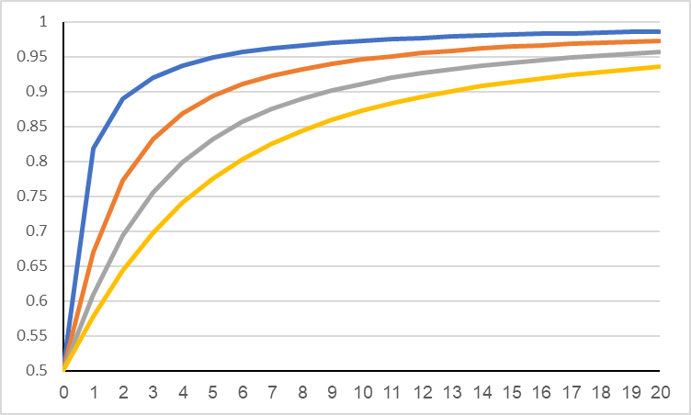
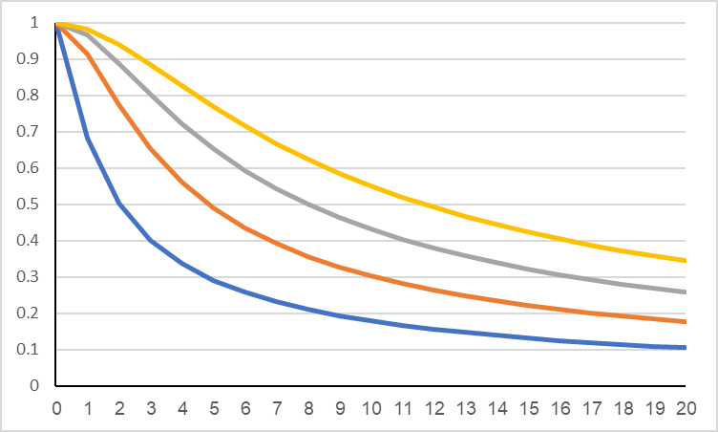














Converge rate - Target exists in $c_{i}$
Expected Probability
$P_{TA}=1$ , $\frac{r_{ij}}{λ\left(k\right)}=0.25$ ,$P(s_{jk}\left(c_{i},0\right))=0.5$
$$α=0$$
$$α=0.25$$
$$α=0.4$$
$$α=0.5$$
$$E[P(s_{jk}\left(c_{i},t\right))]$$
Expected Entropy
$$t$$
$$E[H\left(s\left(c_{i},t\right)\right)]$$
$$α=0.5$$
[bits]
$α=0$.4
$$α=0.25$$
$$α=0$$
$$t$$

Slide 31
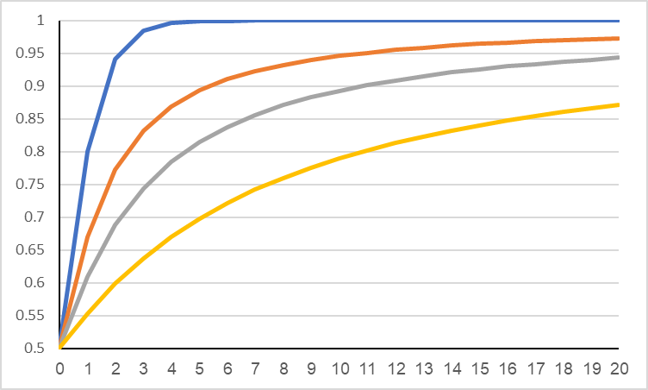
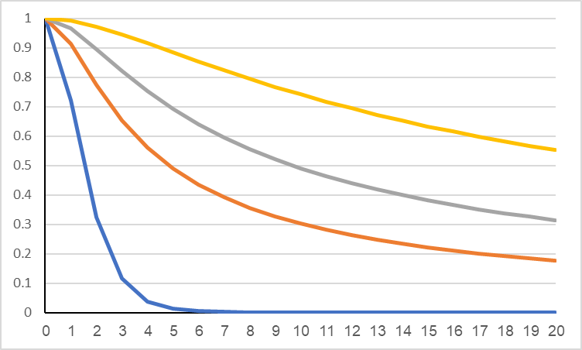














Converge rate - Target exists in $c_{i}$
Expected Probability
$P_{TA}=1$ , $α=0.25$ ,$P(s_{jk}\left(c_{i},0\right))=0.5$
$$\frac{r_{ij}}{λ\left(k\right)}=0$$
$$\frac{r_{ij}}{λ\left(k\right)}=0.25$$
$$\frac{r_{ij}}{λ\left(k\right)}=0.5$$
$$\frac{r_{ij}}{λ\left(k\right)}=1$$
$$E[P(s_{jk}\left(c_{i},t\right))]$$
Expected Entropy
$$t$$
$$\frac{r_{ij}}{λ\left(k\right)}=1$$
$$\frac{r_{ij}}{λ\left(k\right)}=0.5$$
$$E[H\left(s\left(c_{i},t\right)\right)]$$
$$\frac{r_{ij}}{λ\left(k\right)}=0.25$$
[bits]
$$\frac{r_{ij}}{λ\left(k\right)}=0$$
$$t$$

Slide 32


Converge rate - Target doesn’t exist in $c_{i}$
 |  | $$c_{i}$$
Case 2: Target doesn’t exist in $c_{i}$
Expected value of $P\left\{s\left(c_{i},t\right)\right\}$:
$$c_{j}$$
$$E\left[P\left(s_{jk}\left(c_{i},t\right) | Tar\left(c_{i},t\right)=0\right)\right]=P((s_{jk}\left(c_{i},t\right))|\tilde{x}\left(c_{i},t\right)=1)∙P\left(\tilde{x}\left(c_{i},t\right)=1|Tar\left(c_{i},t\right)=0\right)+P((s_{jk}\left(c_{i},t\right))|\tilde{x}\left(c_{i},t\right)=0)∙P\left(\tilde{x}\left(c_{i},t\right)=0|Tar\left(c_{i},t\right)=0\right)$$
$$E\left[P\left(s_{jk}\left(c_{i},t\right) | Tar\left(c_{i},t\right)=0\right)\right]=\frac{P(s_{jk}\left(c_{i},t−1)\right)∙P_{TA}}{P(s_{jk}\left(c_{i},t−1)\right)∙P_{TA}+\left[1−P(s_{jk}\left(c_{i},t−1)\right)\right]∙α∙P_{TA}}∙α∙P_{TA}∙e^{−\frac{r_{ij}}{λ\left(k\right)}}+$$
$$\frac{P(s_{jk}\left(c_{i},t−1)\right)∙\text{[}\left(1−P_{TA}\right)+P_{TA}⋅(1−e^{−\frac{r_{ij}}{λ\left(k\right)}})]}{P(s_{jk}\left(c_{i},t−1)\right)∙\text{[}\left(1−P_{TA}\right)+P_{TA}⋅(1−e^{−\frac{r_{ij}}{λ\left(k\right)}})]+[1−P(s_{jk}\left(c_{i},t−1)\right)]⋅\text{[}(1−α∙P_{TA}\text{)}\text{+}α∙P_{TA}⋅(1−e^{−\frac{r_{ij}}{λ\left(k\right)}})]}{∙(1−α∙P}_{TA}∙e^{−\frac{r_{ij}}{λ\left(k\right)}})$$
$$E\left[P\left(s_{jk}\left(c_{i},t\right) | Tar\left(c_{i},t\right)=0\right)\right]=\frac{P(s_{jk}\left(c_{i},t−1)\right)∙α∙P_{TA}∙e^{−\frac{r_{ij}}{λ\left(k\right)}}}{P(s_{jk}\left(c_{i},t−1)\right)∙\left[1−α\right]+α}+\frac{P(s_{jk}\left(c_{i},t−1)\right)⋅(1−e^{−\frac{r_{ij}}{λ\left(k\right)}}){∙(1−α∙P}_{TA}∙e^{−\frac{r_{ij}}{λ\left(k\right)}})}{P(s_{jk}\left(c_{i},t−1)\right)∙(1−{P_{TA}∙e}^{−\frac{r_{ij}}{λ\left(k\right)}})+[1−P(s_{jk}\left(c_{i},t−1)\right)]⋅ (1−α∙P_{TA}∙e^{−\frac{r_{ij}}{λ\left(k\right)}}\text{)} }$$

Slide 33
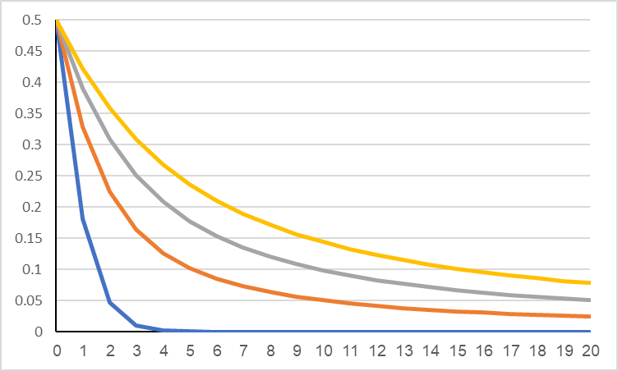











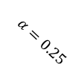
Converge rate - Target doesn’t exist in $c_{i}$
Expected Probability
$P_{TA}=1$ , $\frac{r_{ij}}{λ\left(k\right)}=0.25$ ,$P(s_{jk}\left(c_{i},0\right))=0.5$
$$E[P(s_{jk}\left(c_{i},t\right))]$$
$$α=0.25$$
$$α=0.4$$
$$α=0.5$$
$$α=0$$
Expected Entropy
$$t$$
$$E[H\left(s\left(c_{i},t\right)\right)]$$
[bits]
$$α=0.5$$
$α=0$.4
$$α=0.25$$
$$α=0$$
$$t$$

Slide 34
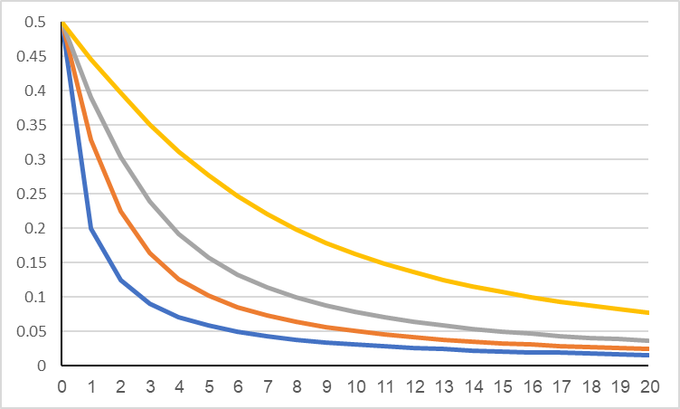
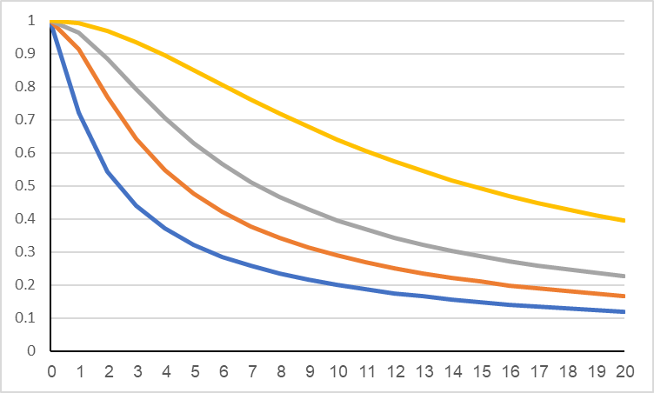








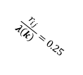

Converge rate - Target doesn’t exist in $c_{i}$
Expected Probability
$P_{TA}=1$ , $α=0.25$ , $P(s_{jk}\left(c_{i},0\right))=0.5$
$$E[P(s_{jk}\left(c_{i},t\right))]$$
$$\frac{r_{ij}}{λ\left(k\right)}=1$$
$$\frac{r_{ij}}{λ\left(k\right)}=0$$
$$\frac{r_{ij}}{λ\left(k\right)}=0.25$$
$$\frac{r_{ij}}{λ\left(k\right)}=0.5$$
Expected Entropy
$$t$$
$$\frac{r_{ij}}{λ\left(k\right)}=1$$
$$\frac{r_{ij}}{λ\left(k\right)}=0$$
$$\frac{r_{ij}}{λ\left(k\right)}=0.5$$
$$E[H\left(s\left(c_{i},t\right)\right)]$$
$$\frac{r_{ij}}{λ\left(k\right)}=0.25$$
[bits]
$$t$$

